Slide 1
Final Mini Project Demonstration
Subject CODE
Project Title : Helmet Detection of Bike Riders
Project Guide : Prof.Sangeetha.V
Project Team : C.R.Greeshma Reddy
(PES1201800196)
Vulli Varsha
(PES1201800376)

Slide 2
Project Abstract and Scope
Our project detects the people who
are wearing and not wearing helmet
during their bike ride when passed a
real time application as input to our
model.

Slide 3
Literature Survey
We went through 3 reference papers regarding Helmet Detection namely:
Detection of Motorcyclists without Helmet in Videos using Convolutional Neural Network by C. Vishnu, Dinesh Singh, C. Krishna Mohan and Sobhan Babu, IIT Hyderabad.
Detecting motorcycle helmet use with deep learning by Felix Wilhelm Siebert, Hanhe Lin
An Improved YOLOv3 for Vehicle Detection by Jun Sang , Zhongyuan Wu, Pei Guo, Haibo Hu, Hong Xiang, Qian Zhang and Bin Cai
From these papers we learned the following things :
We found that Yolov3 model is best for training the dataset as it gives more accuracy compared to models like RetinaNet, R-CNN
Yolov3 model is CNN which is implemented with 24 convolution layers and 2 fully connected layers.

Slide 4
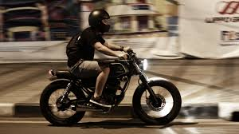
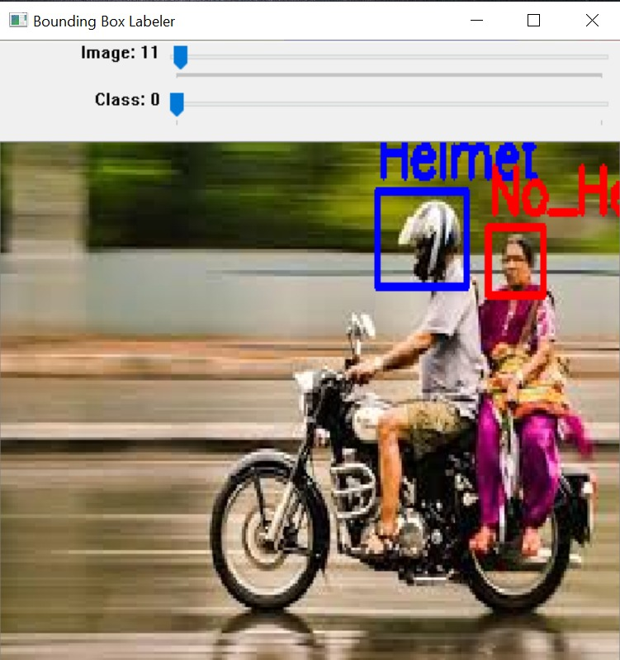
Design Description/UI Design
Data Collection
Labelling of images to get annotations

Slide 5
Training the YoloV3 model to get the updated weights with created dataset
Testing the model to see the model is making correct predictions

Slide 6
Technologies Used
Python
OpenCv
YoloV3
Notes:
‹#›

Slide 7
Implementation
As we are using an already trained model called yolov3,we were supposed to made some changes and again train the yolov3 model and update weights as we are trying to predict a custom object but yolov3 model is trained with around 80 different objects.
Notes:
‹#›

Slide 8
To train our model we first downloaded around 1500 images from the internet.
Then we made a bounding boxes to all the images and stored the annotations of each image.
To get the model well trained we made a copy of yolov3 configurations file and made changes related to classes and filters as our model is going to predict only 2 classes.
Now we trained the model with a darknet detector and the model is trained for around 4000 iterations.

Slide 9
After the training is done we got an updated weights file.
Then using this updated weights file, updated yolov3 configurations file and opencv we were able to predict whether people are wearing helmet or not during their bike ride.

Slide 10
Project Demo
Presenting you with result of our helmet detection model using various images
Notes:
‹#›

Slide 11
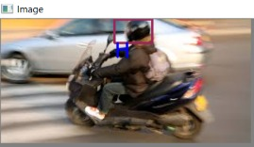
Results for predicting all the people with or without helmet in the image correctly :

Slide 12
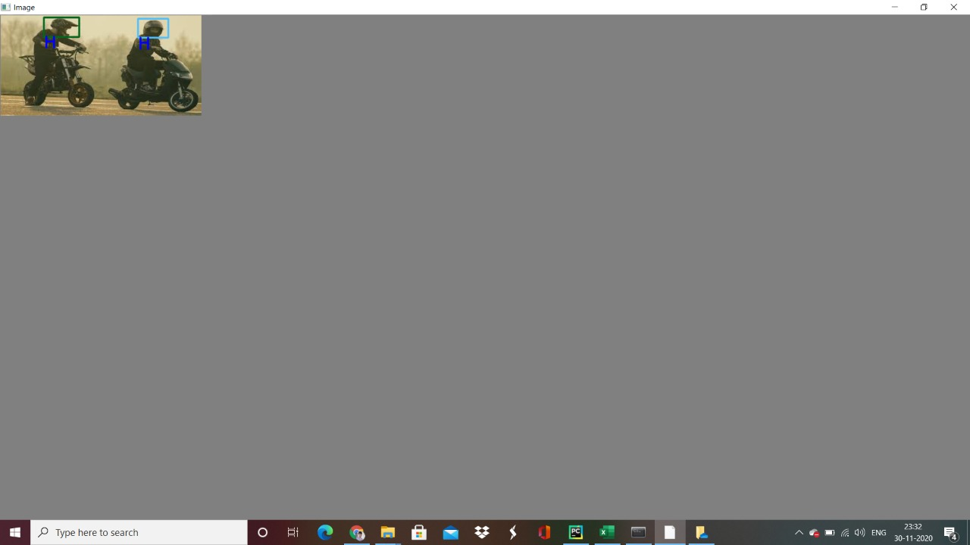


Slide 13
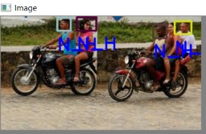
Results for predicting almost all the people with or without helmet in the image correctly :

Slide 14
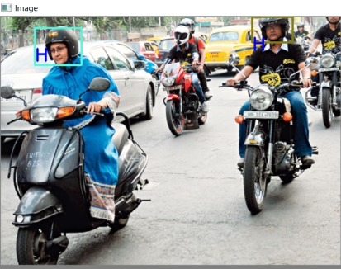
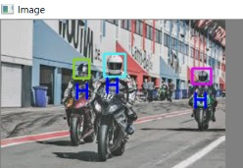

Slide 15
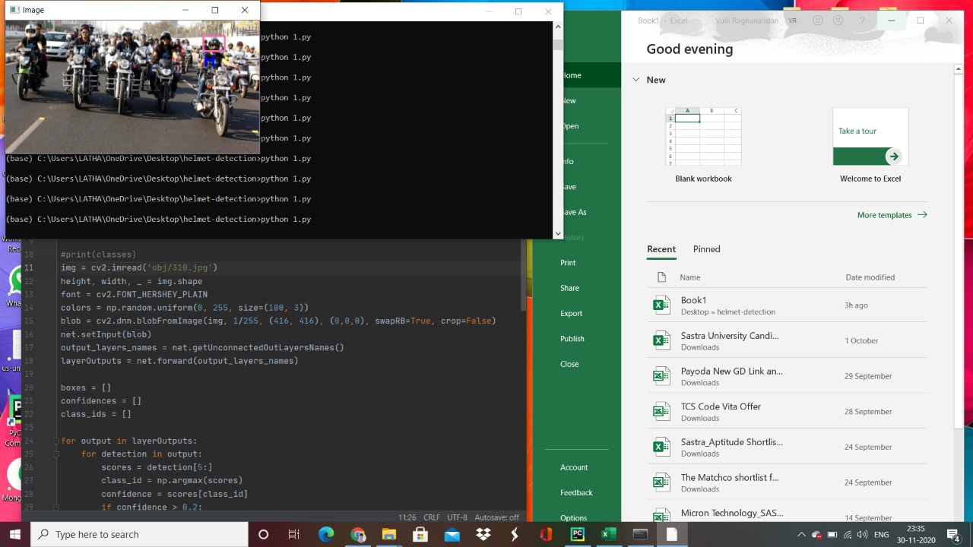
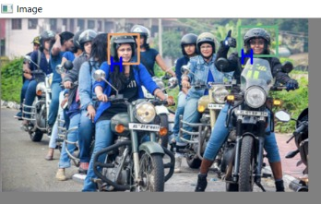
Our model is detecting only the people who are near to the camera if there are large number of persons present in a image

Slide 16
Our model was not detecting all the people if more number persons were present in the image due to lack of more such images in the trained dataset.
But our model is correctly predicting whether a person is wearing helmet or not if the person if the image is detected.
Due to inconsistency present in our dataset our model came up with an accuracy of 89%.

Slide 17
Thank You

